Slide 1
Dynamic Spectrum Access Via Smart Contracts on Blockchain
Thirasara Ariyarathna¹, Prabodha Harankahadeniya¹, Saarrah Isthikar¹,
Nethmi Pathirana¹, Dilum Bandara¹, Arjuna Madanayake²
¹Department of Computer Science and Engineering
University of Moratuwa, Sri Lanka
²Department of Electrical and Computer Engineering
Florida International University, FL, USA
Presented by: Thirasara Ariyarathna
16th April,2019
Notes:
.

Slide 2
Contribution
Wireless spectrum is a now a scarce resource
Dynamic spectrum access (DSA) is a potential solution
Difficult to achieve among untrusted users
Compensation for primary users (PUs) while guaranteed access to secondary users (SUs)
We propose a blockchain-based DSA platform for trusted spectrum sharing between PUs & SUs
A Spectral Token resembles license to access a particular frequency band (FB)
Both PU initiated & SU requested spectrum sharing are supported via smart contracts
Spectral tokens & fees are transferred based on agreed FB, location, & time
Developed a proof of concept solution using 2.4 & 5 GHz ISM bands
Simulation results show acceptable latency & throughput characteristics

Slide 3
Wireless Spectrum
Increasing Demand
Demand for mobile & broadband services has grown exponentially over the years
LTE-U & LTE-LAA to conquer high demand for faster data rates
Establishment of 5G communication
Finite Resource
Physics & costs dictates the use of legacy frequencies in sub 6 GHz range
Already allocated & sold out, therefore heavily congested
High licensing cost per frequency channel
Underutilization
Static spectrum allocation policies
One time or long term
Abundant frequency holes or white spaces
E.g., TV white spaces

Slide 4
Spectrum Sharing
Dynamic Spectrum Access
Cognitive Radio
Transceivers can intelligently detect free channels
Frequently jump between vacant channels
Concerns around cognitive radio
No guarantee of permissioned usage
Lack of guaranteed payments
Uncertainty of misuse
High cost & overhead of formal contracts
Current Standards
Citizen Broadband Radio Service (CBRS)
Enable primary & secondary user access based on 3 priority tiers
PUs could purchase frequency bands from FCC via competitive bidding
PUs may lease unused frequency bands to SUs
IEEE 802.22 (WRAN)
Utilize TV white spaces using cognitive radio capabilities

Slide 5
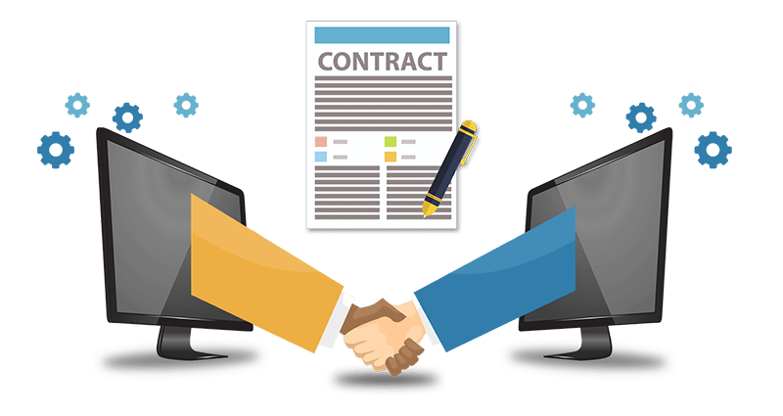
Guaranteed Spectrum Sharing for Untrusted Users
Blockchain
Distributed ledger
Distributed consensus
Public key cryptography & hashing
High available record keeping of transactions
Solves the problem of trusting a third party (Transparency)
Faster than doing manually
Smart Contracts
Self-enforcing
Facilitate contractual clauses digitally
Helps bidding process & transferring of assets with integrity
Fast & low cost

Slide 6
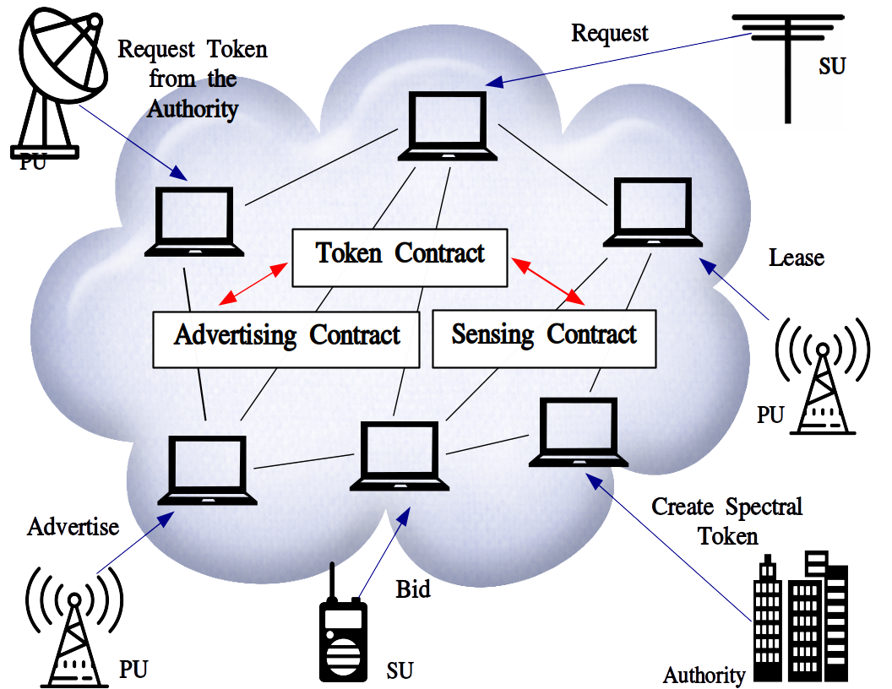
Proposed System Overview

Slide 7
Spectral Token
A token resembles the license to use a frequency band
Uniquely identified by:
Frequency range (startFreq to endFreq)
Location (Depending on how a cell is defined)
Issued: By the token contract that can only be initiated by the authority
Ensure that interference is avoided by enforcing sequential access
2 states: state can only be modified by PU or the authority
Prevents further leasing of license by SU
Lowest frequency range that can be given out
1
2
3
4
5
6
7
8
Example scenario:
Start Frequency: 2.421 GHz
End Frequency: 2.443 GHz
Location: Colombo, Sri Lanka
$$S_{T}\left\{\begin{aligned}leased owner≠primary_user \\ not_leased owner=primary_user\end{aligned}\right.$$

Slide 8
Initial Token Offering (ITO)
To request a license from the authority
PUs can request spectral tokens from authority for unallocated frequency bands
Authority generates spectral tokens & transfer ownership of the spectral token to respective PU

Slide 9
Main Sub Models
Advertise based DSA
To advertise license to SUs
Initiated by PUs
PU can dynamically allocate
Price
Time to lease/bid
Leasing time duration
PU can decide the leasing policy
FCFS
Competitive bidding
Sensing based DSA
To request a license from a PU
Initiated by SUs (sensing)
Once requested, an event is triggered & PU is notified
If PU is willing to lease, request is accepted, else it is declined
If multiple requests, smart contract selects the best offer

Slide 10
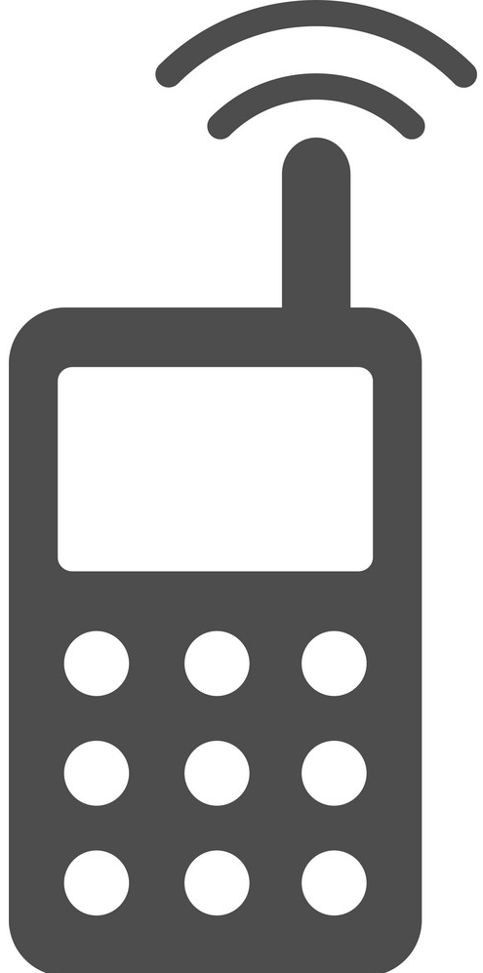
High-Level Workflow
Advertise based DSA model
PU
advertise Spectral Token(s)
Advertise Smart Contract
After bidding time ends
On leasing start time transfer Spectral Token
Bid
Bid
Bid
ETH
ETH
1
2
3
4
5
6
7
SU
SU
SU
SU
ST
ST
PU
SU
request Spectral Token(s)
If accepts
ST
ST
PU
Smart Contracts select best bidder
SU
Accept/decline
Sensing Smart Contract
On leasing end time transfer assets
White Space detection
Sensing based DSA model

Slide 11
Proof of Concept
Utility & performance of the proposed system is demonstrated using 2.4 GHz & 5GHz ISM bands
Assumed channels can be assigned to different PUs
Implementation of proposed platform includes:
Front-end application (for mobile & web-based interfaces)
6 Android Smart phones
Back-end application
Blockchain
Blockchain network using 5 Laptops
Ethereum blockchain platform & smart contracts using Solidity language

Slide 12
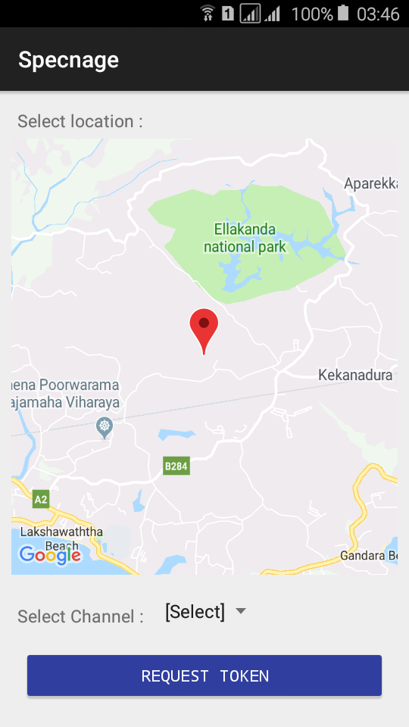
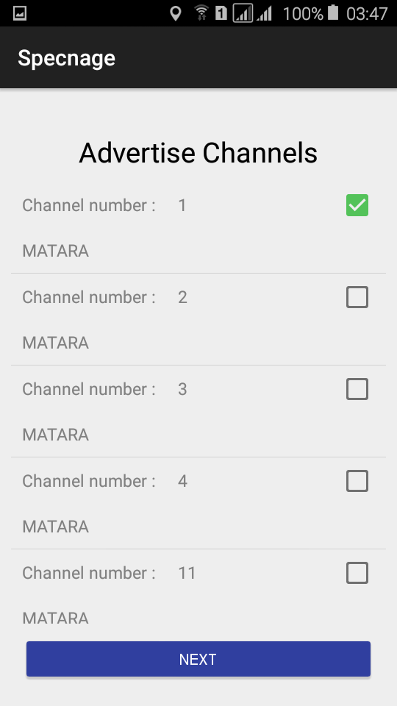
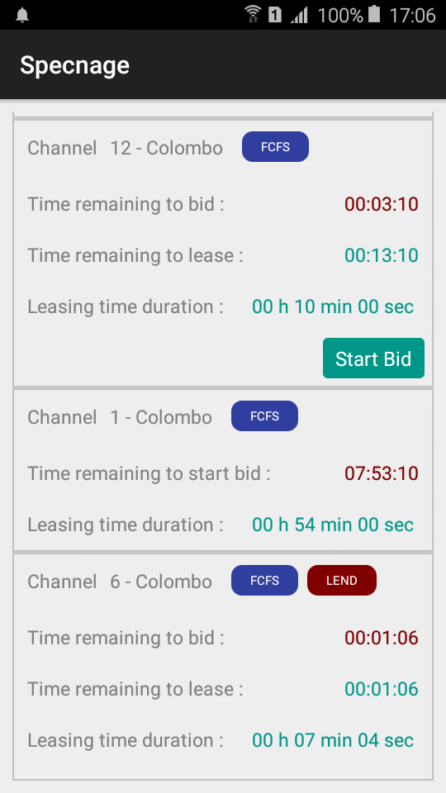
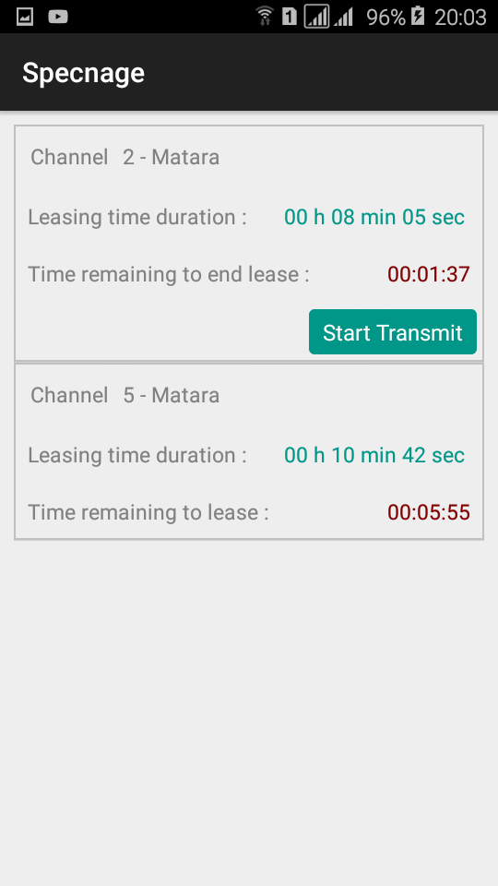
Experimental Setup
PU
Advertise ST
SU
Authority node
Server/
Gateway
Bid
PU
Request ST from Authority
Blockchain network
Request ST
Lease ST
SU
Blockchain communication and control done over
Wi-Fi channel 14
(2473 – 2495 MHz)
PU

Slide 13
Results and Performance Analysis
Performance was analyzed with respect to latency and throughput of the platform
Mobile interface was used for end to end demonstration from sensing to transmitting signals over Wi-Fi channels by creating a hotspot
Model |  | Latency per bidder (lower bound) | No of messages
Advertising based DSA | FCFS | $${4t}_{N}+t_{S}+t_{SB}+$$ $$min(T_{B}, t_{B}+{2t}_{N}+t_{S}+t_{SB})$$ | $$6$$
 | Competitive bidding | $${6t}_{N}+2t_{S}+{2t}_{SB}+T_{B}$$ | $${4+4n}_{B}$$
Sensing based DSA |  | $${4t}_{N}+2t_{S}+t_{SB}+$$ $$min(T_{E}, t_{A}+{2t}_{N}+t_{S}+t_{SB})$$ | $${2+4n}_{R}$$

Slide 14
Results and Performance Analysis Contd.
Latency
Throughput
Latency and Throughput of FCFS leasing transactions with varying no of concurrent requests
With the increasement of no of requests Latency Saturates while throughput increases
Baseline : basic transactions to update the state of the blockchain (transferring virtual currency from one user to another)

Slide 15
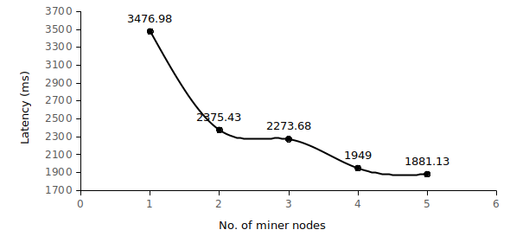
Results and Performance Analysis Contd.
SCALABILITY
Latency for 50 concurrent transactions is measured while varying no of miners
Latency reduced when no of miners increased
Transaction validation process speed up because of computational power increase

Slide 16
Summary
Proposed a token-based dynamic spectrum sharing platform using Blockchain and Smart Contract technologies
Enhances the efficient use of the spectrum while enabling advertising and sensing based dynamic spectrum sharing by primary and secondary users
Blockchain and smart contracts increase the trust on the system and ensures both PUs and SUs share the spectrum as per regulations coded into the platform
Enables license transfer and verification without the mediation of a trusted third party
PoC achieves more than eight transactions per second even with modest hardware
Due to the relatively high latency introduced by the blockchain mining process, the proposed platform is desirable for DSA in use cases like CBRS and IEEE 802.22 WRAN, where spectrum sharing is relatively long lived and into the future.

Slide 17
Thank you!

